Slide 1

Applications list

Slide 2

The Benefits
One-stop-shop
See all your applications and relevant materials in one place.
Clarity
Easily check application deadlines and update your application status’.
Preferences
Rank your applications from most to least preferred.
Dialogue
Request feedback from your tutors on all your applications.

Slide 3
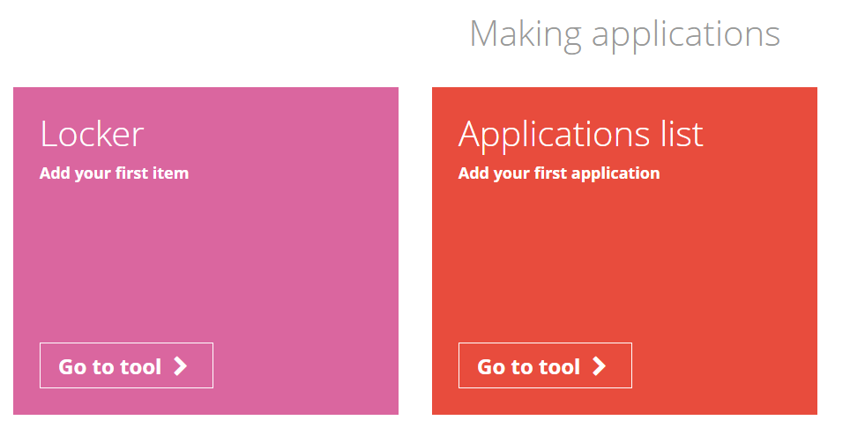
From the student dashboard at unifrog.org/student/home, click on the ‘Go to tool’ button on the Applications list box.

Slide 4
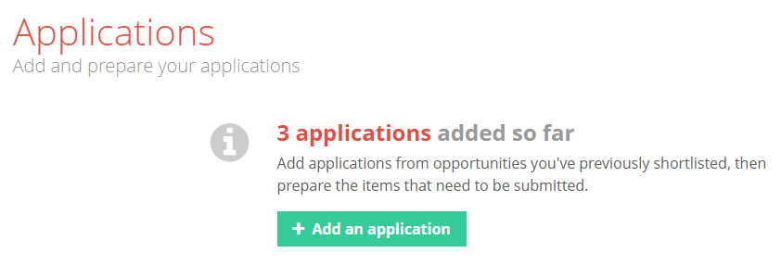
Use the Applications list tool to gather all the items you will need to submit for your university applications. You can add applications for any university or apprenticeship.
You need to have previously created at least one shortlist using one of the university/apprenticeship tools to use the Applications tool!
Click ‘Add an application’ to start the process.

Slide 5
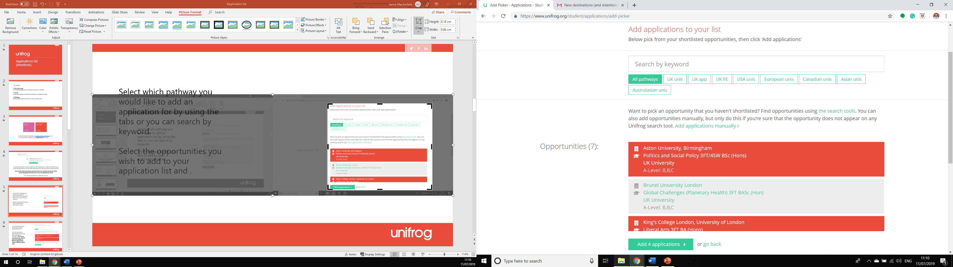
Select which pathway you would like to add an application for by using the tabs or you can search by keyword.
Select the opportunities you wish to add to your application list and .

Slide 6
Click ‘Add applications’ to add the relevant items to your list.
You can also add an opportunity by selecting ‘Add applications manually’. This option should only be used if you were unable to find an opportunity using a Unifrog search tool.

Slide 7
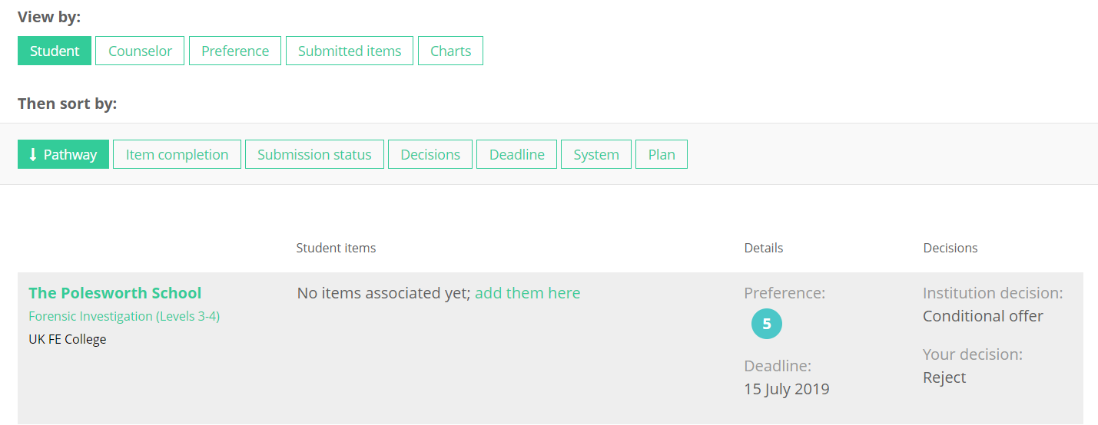
Once you’ve added an application(s) you will be presented with an overview of these.
You can also use the ‘View by:’ and ‘Then sort by:’ tabs to organise these by different criteria.

Slide 8
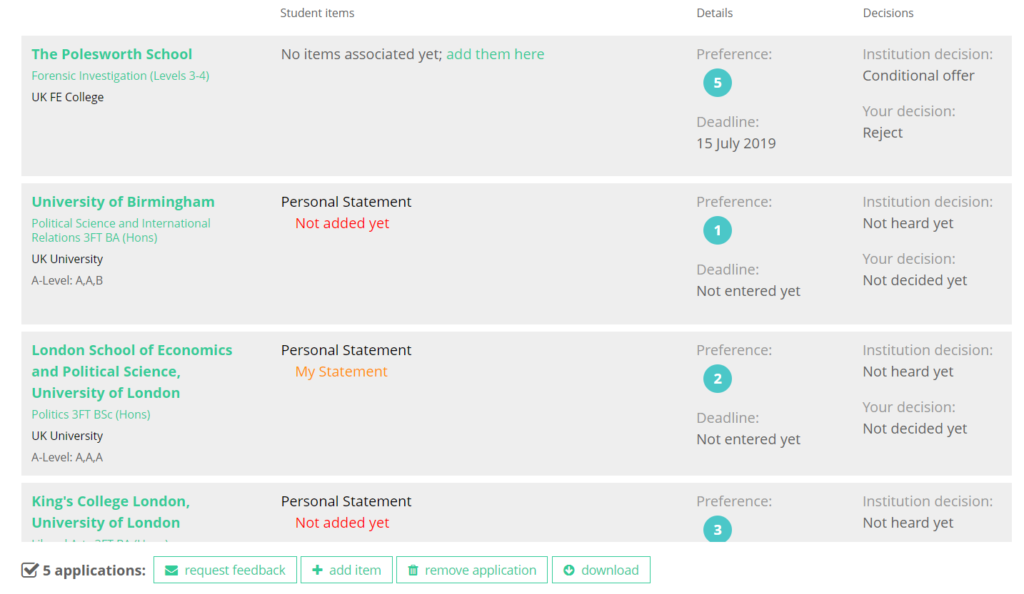
The items you’ve associated with your application (E.g. locker items, CV etc…).
The deadline which you’ve entered, that your application needs to be submitted by.
How you’ve ranked your applications by preference of pursuing the pathways you’ve selected..
The decision which you’ve entered, that the institution has made about your application.
The completed version of the Personal Statement you’ve attached to this application.
The decision which you’ve recorded, about whether you’ve accepted this offer, declined it etc…
Notes:
Teachers’ notes:
As well as confirming/declining offers on the Unifrog platform, students must also log into UCAS Track website to confirm their choices with the universities involved. This is not done automatically when students record their decisions in the Applications list tool.

Slide 9
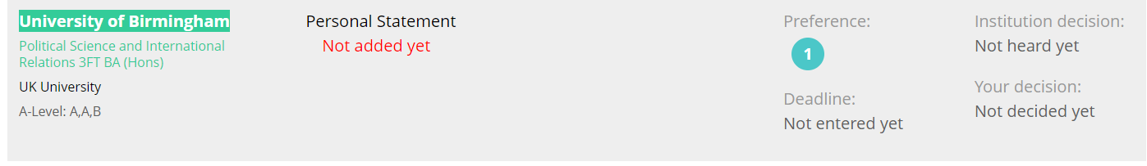
Click on the name of the institution you’re applying to.
Or click ‘Add an item’ on the Student items tab to quickly select a relevant item from your Locker and associate it with the application.

Slide 10
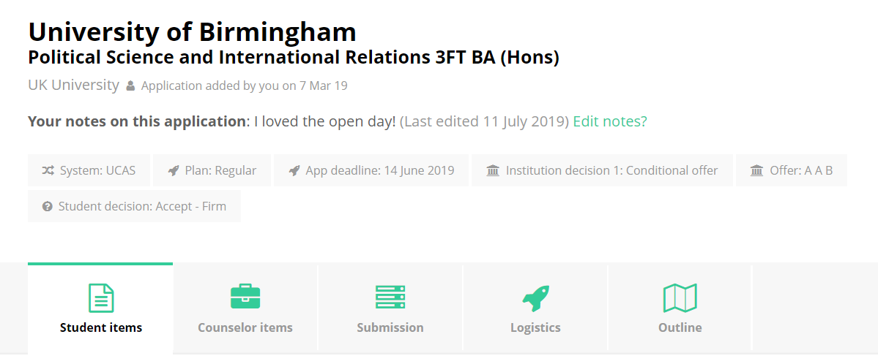
Look at different aspects of the application by selecting the relevant tabs.
You can also add a note to this application.
Click ‘Add an item’ on the Student items tab to select a relevant item from your Locker and associate it with the application.

Slide 11
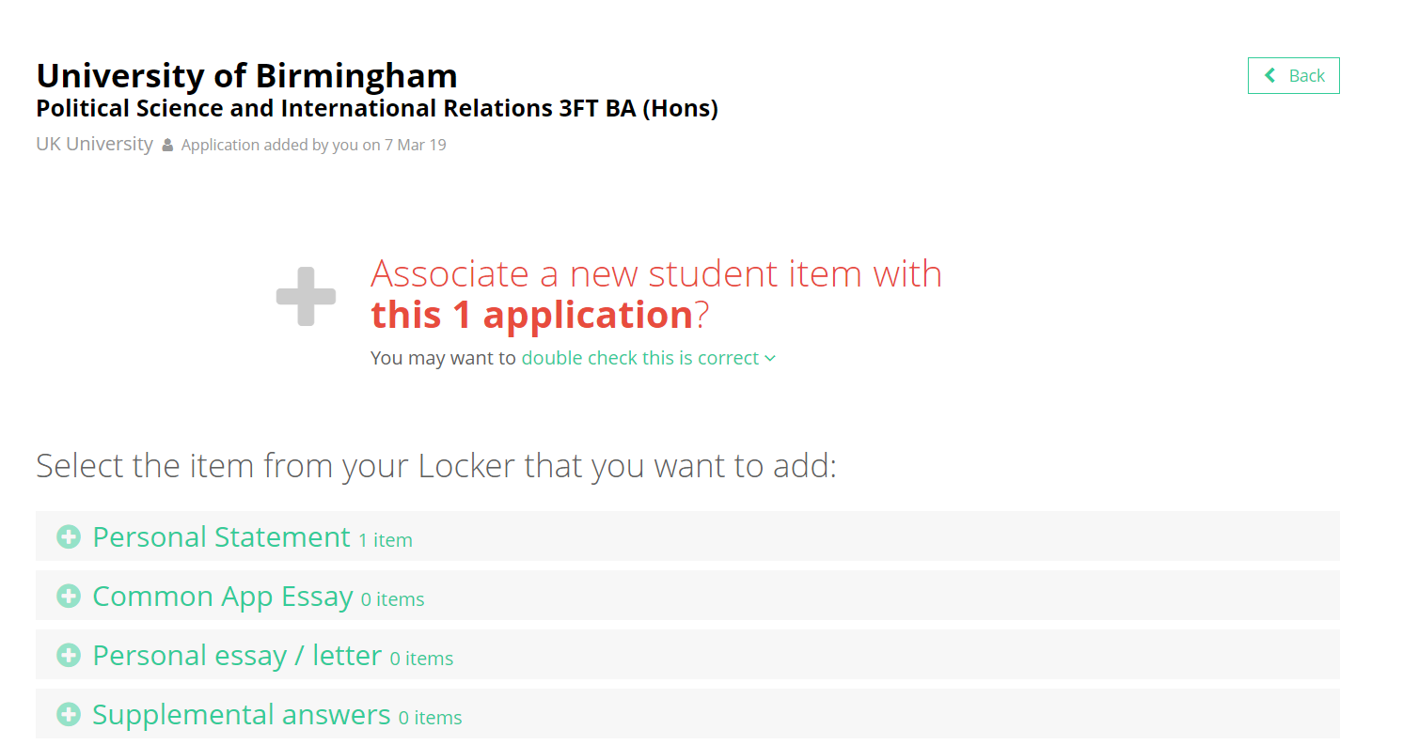
Find the item in your Locker, select the drop down list and click ‘Add this item’.

Slide 12
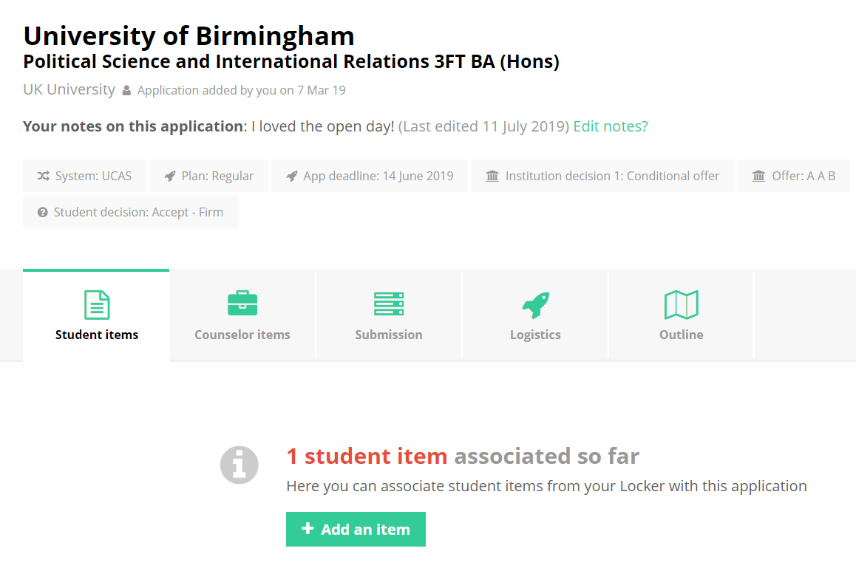
All items you have associated with an application will be listed below the ‘Student items’ tab. Any items your teacher have added will show under the ‘Teacher items’ tab. You can only see these items if your teacher has opted to make them viewable.

Slide 13
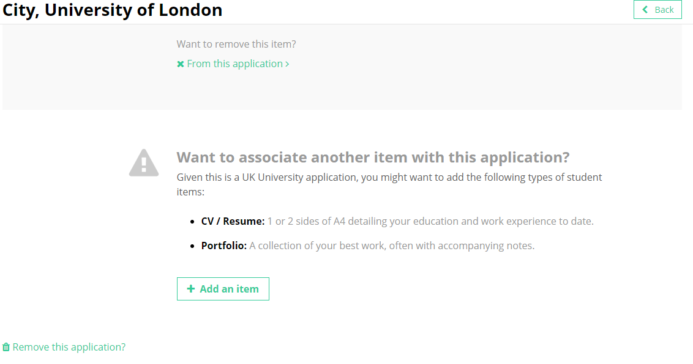
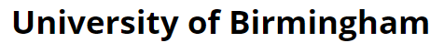
You can remove an item from an application or the whole application at anytime at the bottom of the page of the opportunity.

Slide 14
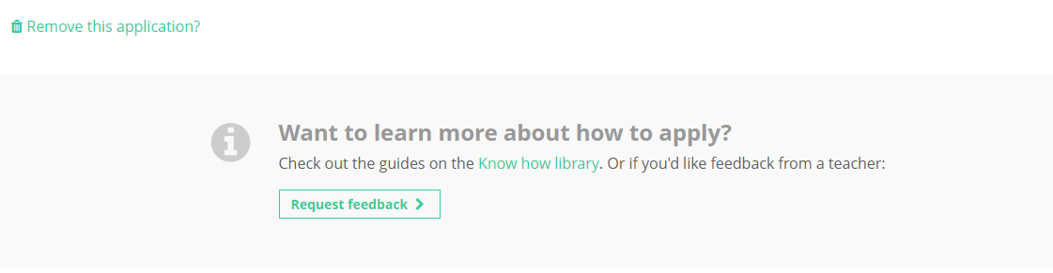
You can also request feedback by selecting the ‘Request feedback’ button.

Slide 15
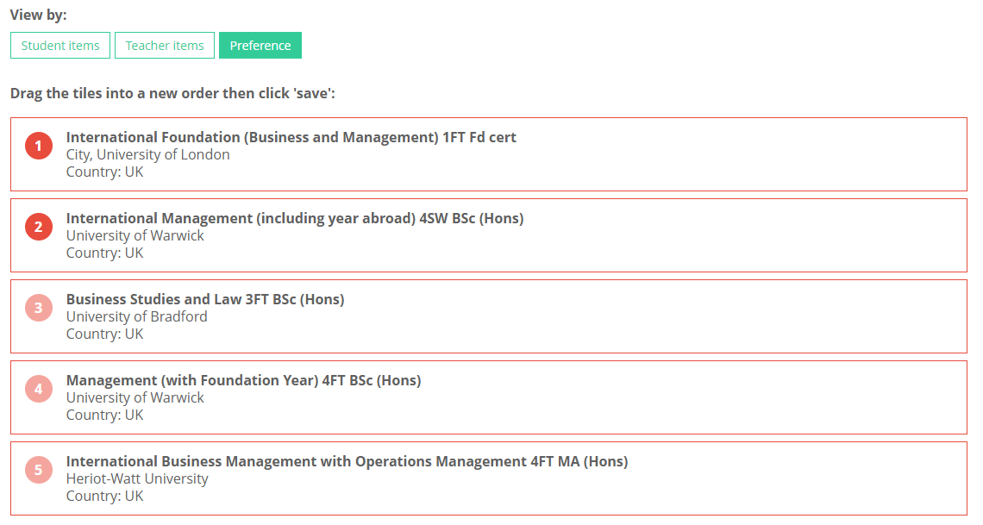
In order to rank your applications, click on the ‘Preference’ tab from the Applications list homepage and drag the tiles to order them. Click ‘save’ at the bottom of the screen when you are finished.

Slide 16










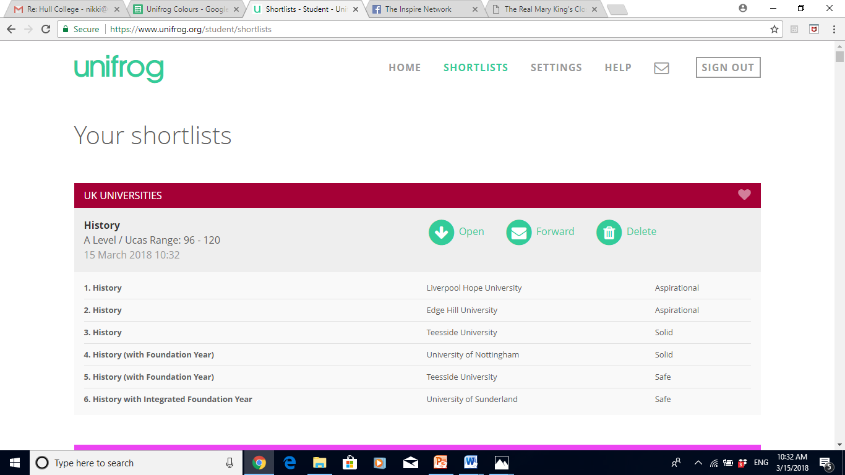
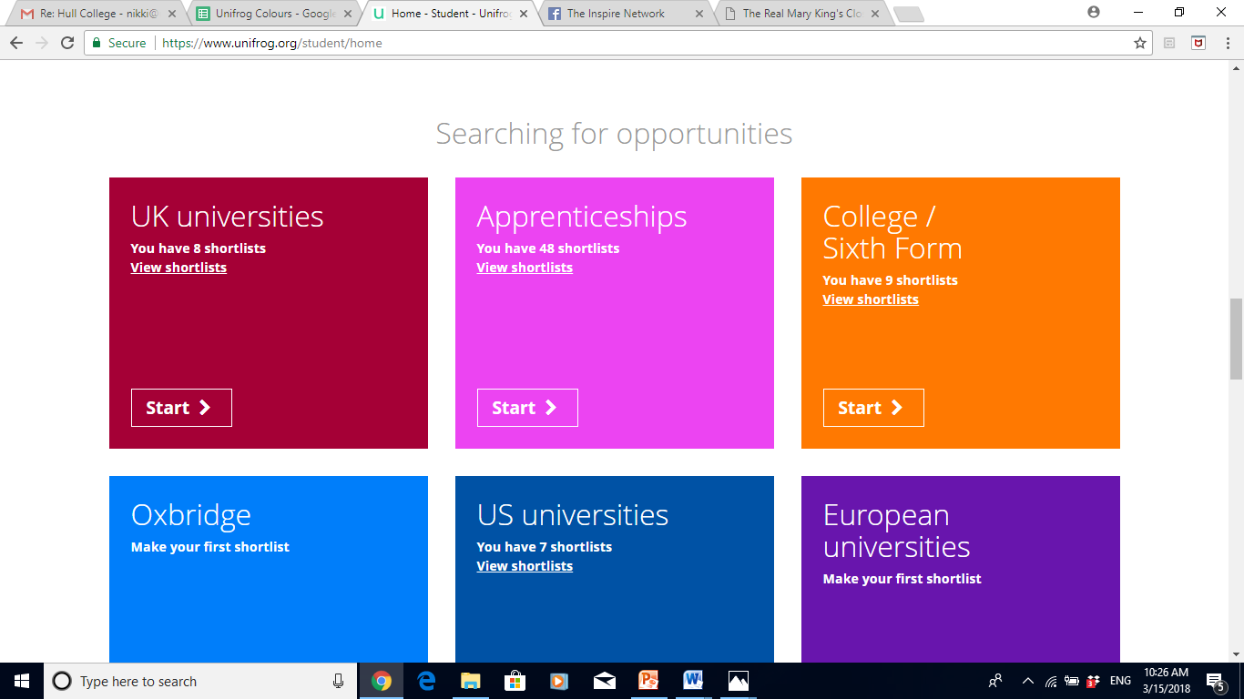
Remember you can make as many Shortlists as you like, and can view them any time by clicking on the Shortlist button on the main dashboard.

